Slide 1
HR Analytics:
Job Change of Data Scientists

Slide 2

Agenda
Project Design
Business Objective
Data Understanding
EDA/Clustering Methods
Data Modeling
Statistical Modeling
Key Learnings
Conclusions
Model Results
Recommendations
Next Steps

Slide 3

The Business Problem
Retaining quality employees is more important than ever. The current job market is extremely competitive, with companies across many sectors struggling to fill positions.
Data Scientist positions are no exception. Talented data scientists have a wealth of opportunities available to them, and replacing them can be time-consuming and expensive. Predicting which employees are most likely to change jobs can help retain key employees and maintain stability.
To answer this question, we will employ data mining and modeling techniques on an employment dataset from a company that is active in Big Data and Data Science.

Slide 4
Project Objectives
Create a classification model to predict the likelihood of an employee switching jobs
Identify groups (clusters) of employees with similarities in the data
Generate insights into how key factors from the model affect employee turnover
Provide actionable suggestions on how companies can increase retention of Data Scientists
Recommend areas for further study

Slide 5
Data Understanding

Slide 6
Dataset Overview
19,158
13
Classification Problem
Row Counts
Features
Target variable-looking for job or not
Data Source-Quality: HR Analytics: Job Change of Data Scientists | Kaggle
Kaggle dataset with 13 features related to employees of a client employing data scientists. Fields include categorical variables such as type of company, gender, and city as well as quantitative variables such as years of experience and training hours.
Final column is our target variable (a binary variable). Our main objective is to predict whether or not an employee is seeking outside employment. The training set contains 19,158 rows.

Slide 7
Feature | Description | Data Type
enrollee_id | Unique ID for candidate | Numbers (i.e. 8949, 29725)
city | City code | Strings (i.e. city_103, city_40)
city_ development _index | Development index of the city (scaled) | Numbers (i.e. 0.92, 0.776)
gender | Gender of candidate | Strings (i.e. Male, Female)
relevent_experience | Relevant experience of candidate | Strings (i.e. Has relevant experience)
enrolled_university | Type of University course enrolled if any | Strings (i.e. no_enrollment)
education_level | Education level of candidate | Strings (i.e. Masters)
major_discipline | Education major discipline of candidate | Strings (i.e. Business Degree)
experience | Candidate total experience in years | Numbers (i.e. 15)
company_size | No of employees in current employer's company | Strings (i.e. 1000-4999)
company_type | Type of current employer | Strings (i.e. Funded Startup)
lastnewjob | Difference in years between previous job and current job | Numbers and Strings (i.e. never, >4)
training_hours | training hours completed | Numbers (i.e.36)
target | 0 Not looking for job change, 1 – Looking for a job change | Boolean
Notes:
For strings data types, we often convert data to categorical variables

Slide 8

Data Understanding
A dataset with 13 features. Models trained on 19,158 observations.
Data limitations:
Missing values
Masked data
Large numbers of categorical features
Imbalanced data
Highly skewed data features
Relatively few features
Data delimitations:
Imputation
Ordinal Encoding
Convert categorical data into indicator variables (get_dummies)
Generate synthetic samples (SMOTE) / Class_weights
Log Transformation / BoxCox
Create new features
Notes:
Imputation: Handling missing value
Ordinal Encoding: encode categorical data to numbers before you can fit and evaluate a model.
Convert categorical data into indicator variables (get_dummies)
Smote: covered in the later section
Log Transformations/Box-Cox: handle outliners and transform highly skewed data to normal
Create new features: explored the possibility of creating new categorical new feature based on Relevant Experience and Overall Experience. Identify highly experienced professionals with low relevant experience.

Slide 9
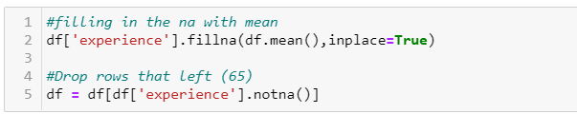
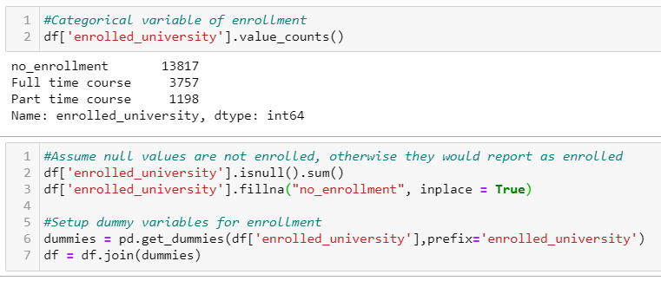
Imputation
Impute missing values with the mean of data (numerical data)
Impute missing values with the mode of data (categorical data)
Notes:
-smart imputation based on related columns/look at trends

Slide 10
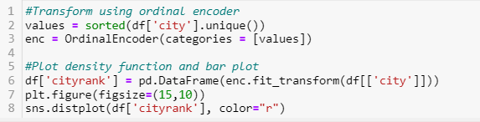
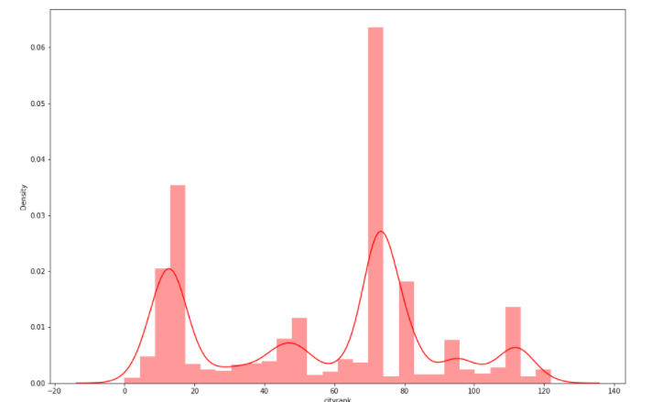
Ordinal Encoding
Since City ID is a masked variable and we have little insight on what city corresponds to, we converted City ID to numbers and applied an ordinal encoder technique to it.
Notes:
Deal with categorical feature for masked data – transform to numerical/rank order (transformation applied to make the feature useable)
An ordinal encoding involves mapping each unique label to an integer value
string to number
rank order ( masked data - city index)
line - density
bar - historgram

Slide 11
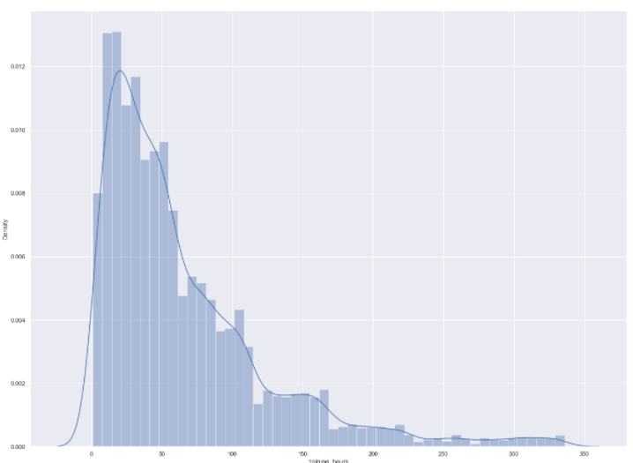
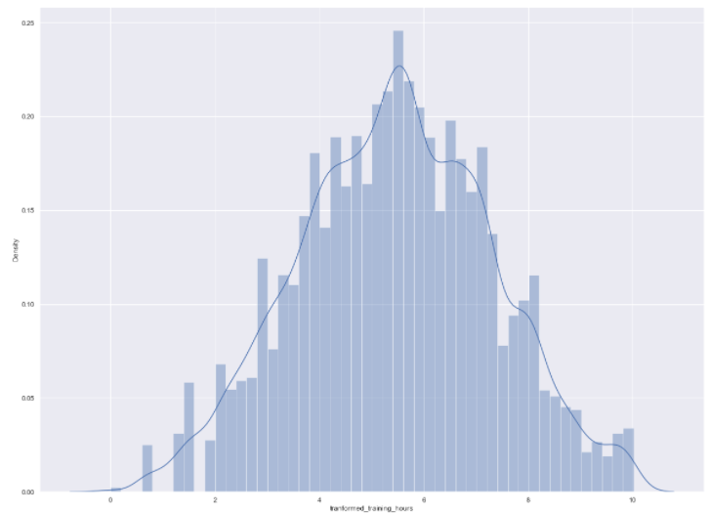
BoxCox
Apply Box-Cox to training _hours variable to transform right skewed to be normally distributed ( transform outliers)

Slide 12
Exploratory Data Analysis (EDA)

Slide 13
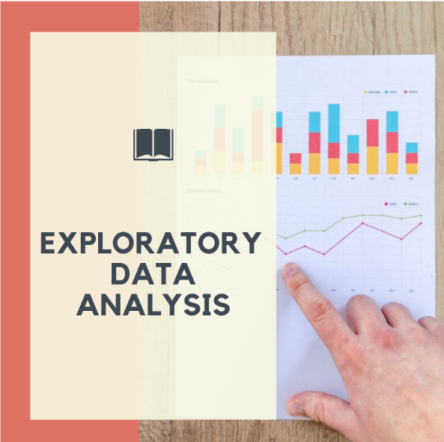
Clustering Method
The following Data Clustering techniques applied to the dataset for data cleaning:
t-SNE
k-Means (PCA visualization of the clusters)
DBSCAN
Notes:
Clustering Analysis used as a data analysis technique for discovering interesting patterns in data, such as groups of customers based on their behavior.

Slide 14
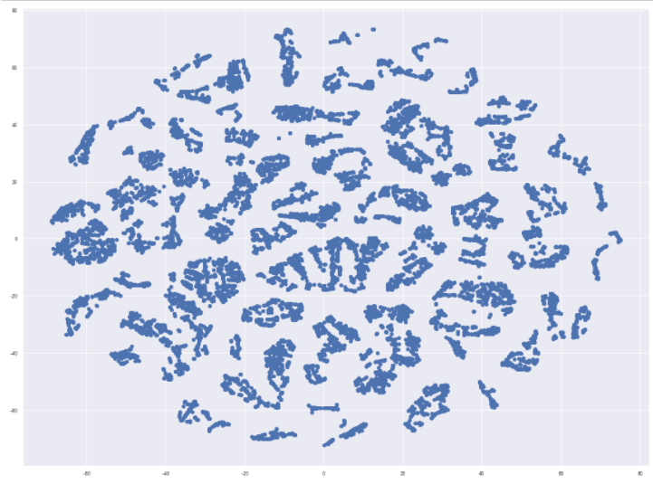
T-SNE showed a large number of small clusters (70+ clusters), which is complex to model separately. Explored other means to identify the clusters distribution.
t-SNE

Slide 15
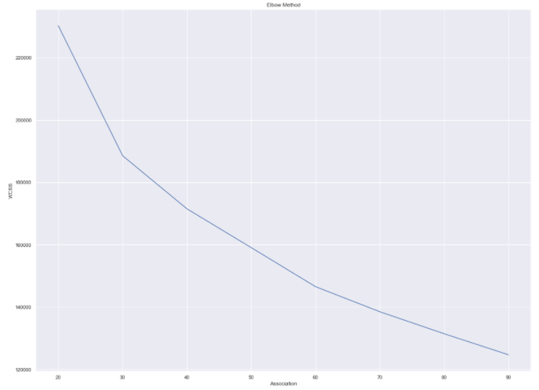
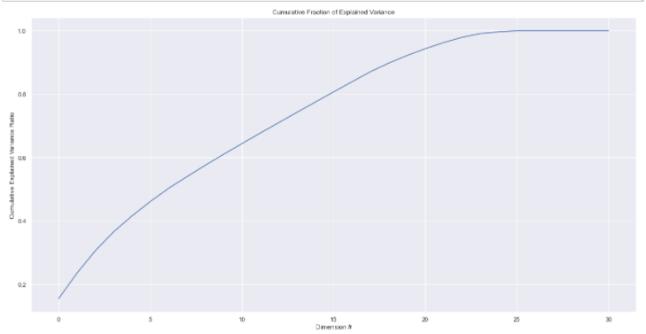
k-Means
Selected 70 clusters using the Elbow Method
20 of 31 dimensions explained more than 90% of variance (PCA), which indicates that several dimensions are important
Notes:
Using the Elbow Method picked 70 clusters
Leveraged PCA feature reduction to visualize the 70 clusters by most important feature
20 dimensions explain more than 90% of variance ( most of the dimensions are useful)

Slide 16
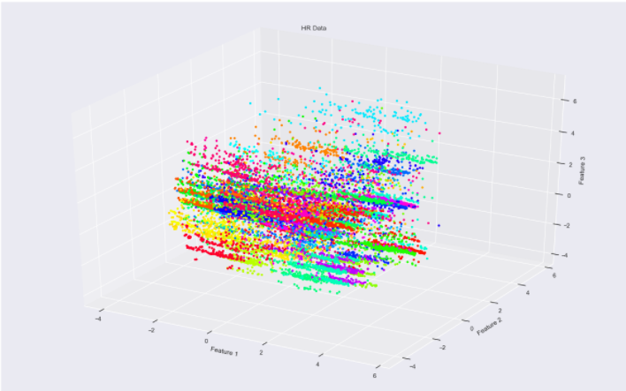
k-Means cont.
Visualize 70 clusters with top 3 PCA dimensions
Conclusion: Visualization did not reveal any interesting cluster patterns of the data, which further confirmed the complexity of the data.
Notes:
Reduced to 20 dimensions and visualize the top 3 dimensions
Had 31 and got down to 20 ( PCA did perform well)
More features ( confirmed the complexity of the data)

Slide 17
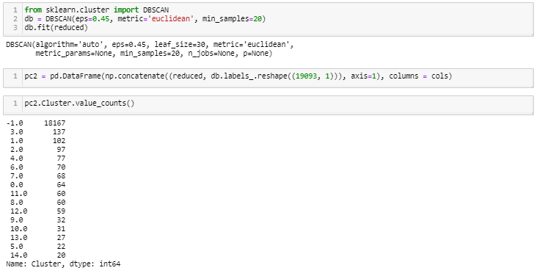
DBSCAN
DBSCAN performs well at detecting outliers from dense clusters.
Conclusion: With a large portion (18,167) falling under outlier class (-1), we are unable to distinguish cluster distribution.

Slide 18
Data Modeling

Slide 19
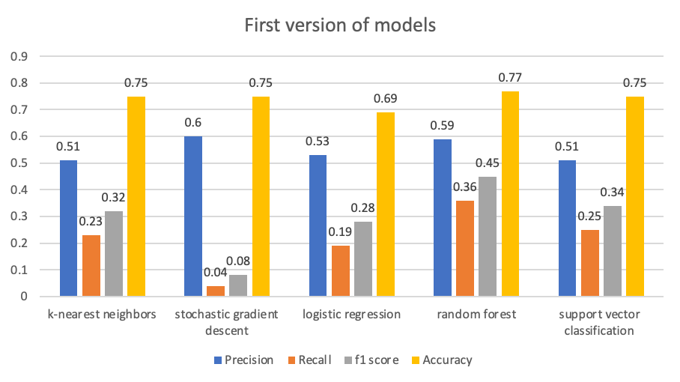
Model - First Versions
First versions of five models showed consistently low recall scores, ie the models could not pick out true job changers from all job changers. False negatives or Type II errors were high in all models. Random Forest showed the best results (relatively) along with feature importances, we leveraged that to improve the models.
k-nearest neighbors | An object is assigned to the class most common among k nearest neighbors, we plotted accuracy of 1-14 neighbors, and picked 10 neighbors in the final model.
stochastic gradient descent | SGD is an optimization method that works on a linear classifier with loss function options of log, hinge or modified huber. We used grid search that picked a hinge loss (akin to linear SVM).
logistic regression | It predicts probability that an entry is in a category by modeling a sigmoid function, and assigns classes based on a threshold. We used grid search to optimize and picked solver=lbfgs, and max_iter=20. We also built a version post-SMOTE.
random forest | An ensemble learning method that constructs many decision trees, the output is the class selected by most trees. We used grid search to optimize max depth, min leaf size, min split size, n_estmators etc.We also built a version post-SMOTE.
support vector classification | A non-probabilistic linear classifier that maps to points in space to maximise width of the gap between categories. We tried linear, poly and rbf kernels, and optimized grid search for a Radial Basis Function (RBF) kernel trick.

Slide 20
Model Engineering
To improve the models, we first looked at the most important features from model random forest and did some transformations on the top features:
Training Hours changed from Log to BoxCox
“>20 years” Experience split up based on most correlated variable (Last New Job)
Company Size changed from categorical to numeric by taking mean of the range
Company Size null filled based on mean size by Company Type
We also added new functionality to the grid search to specifically improve the models
scoring = 'f1'
class_weight = ‘balanced’ , class_weight={0:1,1:2}, SMOTE
Grid Searches with more hyperparameters
Removed some dummy variables like Experience Contrast that we created initially, in order to reduce overfitting

Slide 21
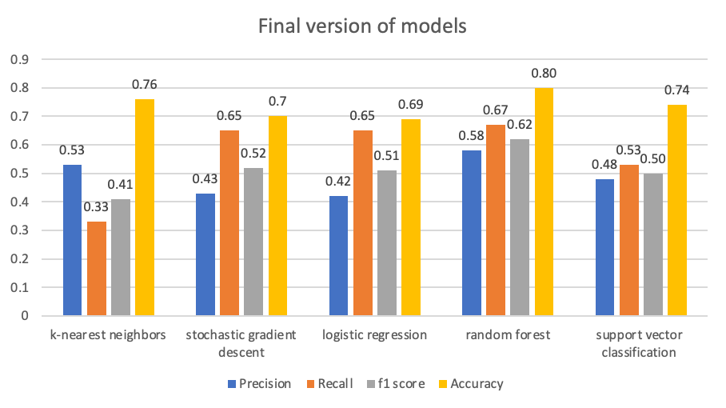
Best Model (accuracy and f1) : Random Forest
All models showed improvement in recall scores after the changes made. Random Forest ended up with the best scores.
Cross Validation of Random Forest (10-fold)
Training Data Set Accuracy: 0.831
Training Data CV Accuracy: 0.795
Test Data Set Accuracy: 0.795
Training Data f1 Score: 0.688
Training Data CV f1 Score: 0.617
Test Data Set f1 Score: 0.621
There is still some overfitting in the training model after simplification of removing some dummy variables. However CV scores are in line with the test scores, so we feel comfortable with the model.

Slide 22
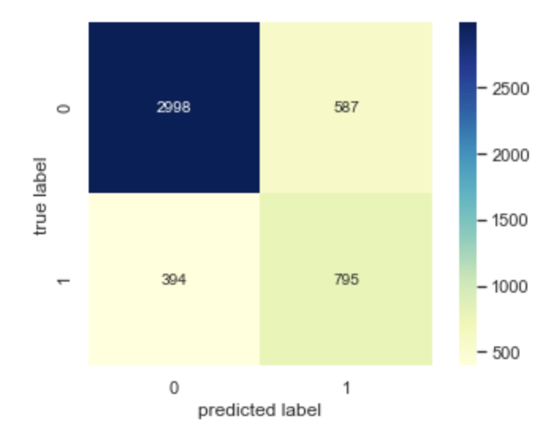
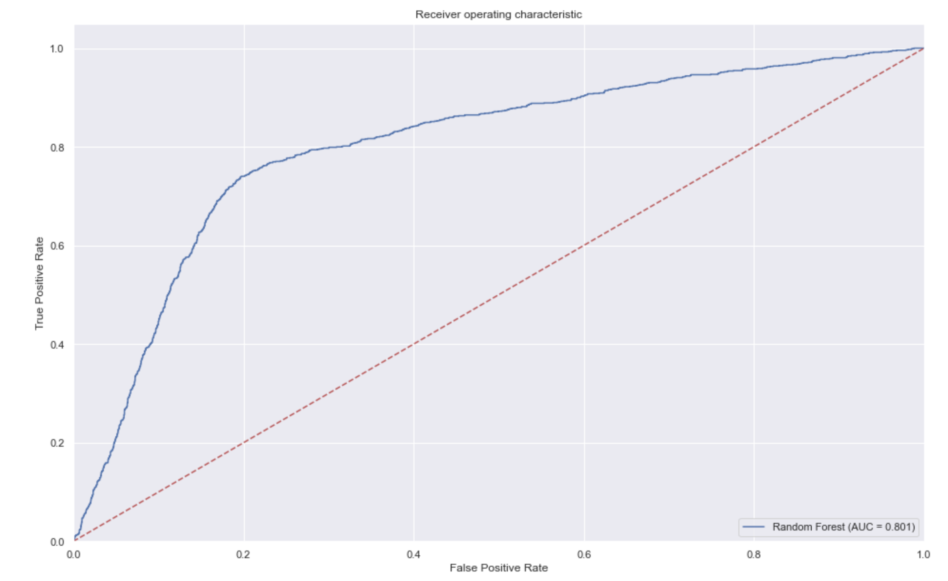
Random Forest Confusion Matrix, ROC curve
ROC Curve (AUC = 0.801)
ROC curve plots the true positive rate (aka recall) against the false positive rate defined as FP/(FP+TN)

Slide 23
Model Results, Recommendations and Next Steps

Slide 24
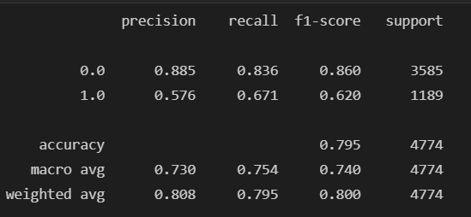
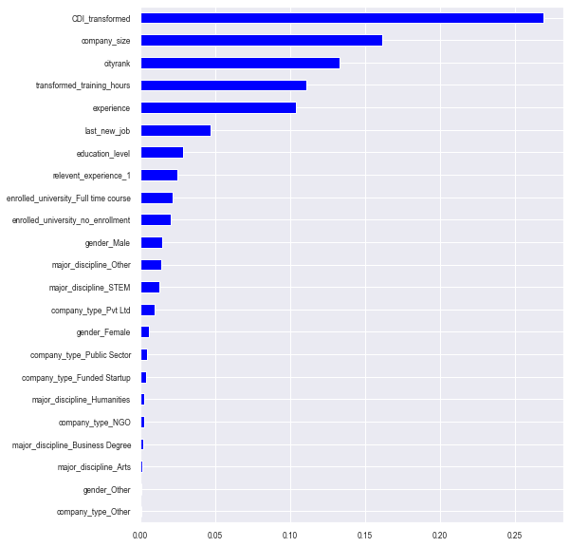
Model Results & Interpretation
Category “1” Model Performance
Precision = tp / (tp + fp) = 0.58
Recall = tp / (tp + fn) = 0.67
F1-score = 2*((precision*recall)/(precision+recall)) = 0.62
Acceptable to sacrifice some precision for “1” value in order to achieve a higher recall level…Identify employees who are at risk of leaving
Feature Performance
"Practical features” / interpretable concepts
Quality dataset: top 10 features reduce 92% of the impurity
Top three features (0.50+) are variables companies can directly influence (i.e. not characteristics of the individual)

Slide 25
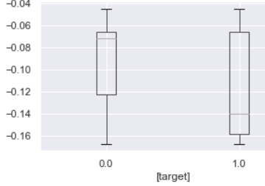
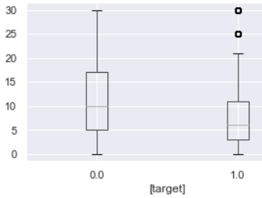
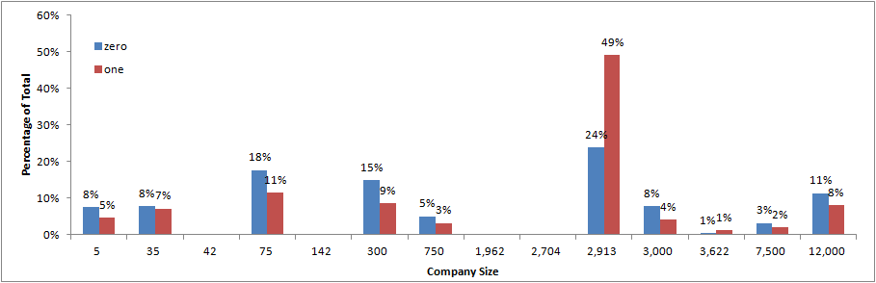
Feature Interpretation – Examples
CDI Index
Lower CDI index for group which is “searching”
Experience
Lower experience IQR range for group which is “searching”
Company Size
Difficult to discern a decisive trend looking at the variable on its own
On average skewed larger for “1” category
Not all the trends are obvious on a standalone basis…Complexity of predictions persists

Slide 26
Top 10 Features Summary
In a nutshell:
Employees who are…
Experienced,
working in smaller companies,
in desirable locations
…are less likely to switch out

Slide 27
Business Recommendations and Next Steps
Recommendations
Location: Offices in desirable locations can drive lower employee turnover. As an alternative companies can implement more work from home initiatives to save on costs
Company: Even if business is a large enterprise, seek to establish “start-up” culture to keep employees interested and engaged
Individuals: Experienced employees are less likely to switch. However, find ways to keep workforce engaged…Training factor demonstrates that investing in employees appears to work
Next Steps - Data
Improve understanding of primary data / applicability / collect more variables to improve model performance
Perform graph analysis on data
Further analysis of feature importance (e.g. using SHAP) / graphing of random forests
Further optimization towards higher recall for “1” target category
Next Steps - Business Initiatives
Develop relevant initiatives to retain employees at risk
Understand impact from recent trend of work-from-home on importance of location
Understand range of applicability to other sectors

Slide 28
Q&A

